Slide 1
Chapter 1
Introduction to Statistics

Slide 2
Statistics
Statistics: Branch of math that focuses on the interpretation of a group of numbers
Two branches of statistics:
  Descriptive statistics: Summarize/organize scores
  Inferential statistics: Drawing conclusions/making inferences that go beyond the original scores

Slide 3
Why Learn Statistics?
Foundation of Psychological Research
Critical thinking skills
Practical applications
Math is fun?
Notes:
Foundation of Psychological Research
Statistics are essential for designing experiments, analyzing data, and interpreting results. They enable psychologists to draw valid conclusions and make evidence-based decisions.
Enhanced Critical Thinking Skills
Learning statistics develops problem-solving abilities and analytical thinking, which are valuable in various aspects of psychology and beyond.
Practical Application in Various Fields
Whether in clinical, social, or industrial psychology, statistical knowledge is applied in assessing treatments, understanding behavior, and implementing interventions.

Slide 4
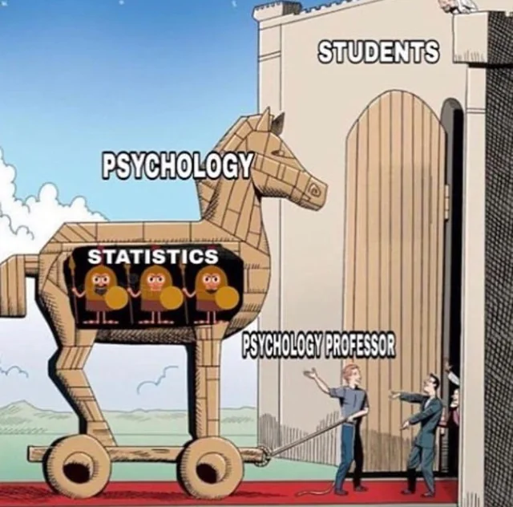
Why Psychology?
Notes:
I’m a psychologist, not a statistician!

Slide 5
Basic Concepts
Variable
  A characteristic that can have different values
Value
  A possible number or category that a score can have
Score
  A particular person’s value on a variable
Notes:
A 20 year old has a score of 20 on the variable age
Thus, this person’s score of 20 is one of many possible values of age
The variable in this case is age

Slide 6
Types of Data Analysis
Quantitative Methods
  Testing theories using numbers
Qualitative Methods
  Testing theories using language
Notes:
Magazine articles/Interviews
Conversations
Newspapers
Media broadcasts

Slide 7
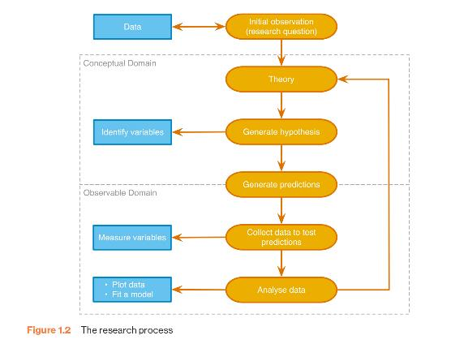
Statistics and Research (1)
Notes:
Find something that needs explaining
Observe the real world
Read other research
Test the concept: collect data
Collect data to see whether your hunch is correct
To do this you need to define variables
Anything that can be measured and can differ across entities or time

Slide 8
Statistics and Research (2)

Slide 9
Generating and Testing Theories
Theories
  A hypothesized general principle or set of principles that explain known findings about a topic and from which new hypotheses can be generated.
Hypothesis
  A prediction from a theory.
  E.g. the number of people turning up for a reality TV audition that have narcissistic personality disorder will be higher than the general level (1%) in the population.
Falsification
  The act of disproving a theory or hypothesis.
Notes:
How to falsify?

Slide 10
Hypothesis Example
 | No Disorder | Disorder | Total
Selected | 3 | 9 | 12
Rejected | 6805 | 845 | 7650
Total | 6808 | 854 | 7662
Notes:
Estimated at .5 – 2% for US population
75% in the selected
11% in the rejected group
11% in the overall audition group

Slide 11
The Research Process (3)

Slide 12
Collect Data to Test Your Theory
Hypothesis:
  High social media use is associated with greater sense of belonging
Independent Variable (IV)
  The proposed cause
  A predictor variable
  A manipulated variable (in experiments)
Dependent Variable (DV)
  The proposed effect
  An outcome variable
  Measured not manipulated (in experiments)

Slide 13
Levels of Measurement (1 of 2)
Categorical (entities are divided into distinct categories):
  Binary variable: There are only two categories
    e.g. dead or alive
  Nominal variable: There are more than two categories
    e.g. whether someone is an omnivore, vegetarian, vegan or fruitarian
  Ordinal variable: The same as a nominal variable but the categories have a logical order
    e.g. whether people got a fail, a pass, a merit or a distinction in their exam

Slide 14
Levels of Measurement (2 of 2)
Continuous (entities get a distinct score):
  Interval variable: Equal intervals on the variable represent equal differences in the property being measured
    e.g. the difference between 6 and 8 is equivalent to the difference between 13 and 15.
  Ratio variable: The same as an interval variable, but the ratios of scores on the scale must also make sense
    e.g. a score of 16 on an anxiety scale means that the person is, in reality, twice as anxious as someone scoring 8.

Slide 15
Measurement Error
Measurement error
  The discrepancy between the actual value we’re trying to measure, and the number we use to represent that value.
Example:
  You (in reality) weigh 80 kg.
  You stand on your bathroom scales and they say 83 kg.
  The measurement error is 3 kg.
Notes:
80kg = 176.37
3kg = 6.61

Slide 16
Validity
Whether an instrument measures what it set out to measure.
Content validity
  Evidence that the content of a test corresponds to the content of the construct it was designed to cover
Ecological validity
  Evidence that the results of a study, experiment or test can be applied, and allow inferences, to real-world conditions.
Notes:
Many types of validity. Let’s just focus on these two for now

Slide 17
Reliability
Reliability
  The ability of the measure to produce the same results under the same conditions.
Test-Retest Reliability
  The ability of a measure to produce consistent results when the same entities are tested at two different points in time.

Slide 18
How to Measure? (1)
Correlational research:
  Observing what naturally goes on in the world without directly interfering with it.
Cross-sectional research:
  This term implies that data come from people at different age points with different people representing each age point.
  Commonly used in developmental studies!

Slide 19
How to Measure? (2)
Experimental research:
  One or more variable is systematically manipulated to see their effect (alone or in combination) on an outcome variable.
  Statements can be made about cause and effect.
  The experimental research strategy is the only one that can infer cause!

Slide 20
Experimental Research Methods (1)
Cause and Effect (Hume, 1748)
  Cause and effect must occur close together in time (contiguity);
  The cause must occur before an effect does;
  The effect should never occur without the presence of the cause.

Slide 21
Experimental Research Methods (2)
Confounding variables: the ‘Tertium Quid’
  A variable (that we may or may not have measured) other than the predictor variables that potentially affects an outcome variable.
  E.g. the relationship between breast implants and suicide is confounded by self-esteem.

Slide 22
Experimental Research Methods (3)
Ruling out confounds (Mill, 1865)
  An effect should be present when the cause is present and that when the cause is absent the effect should be absent also.
  All confounds must be accounted for!
  Control conditions: the cause is absent. Effect must not occur in the absence of the cause!

Slide 23
Methods of Data Collection
Between-group/Between-subject/independent
  Different entities in experimental conditions
Repeated measures (within-subject)
  The same entities take part in all experimental conditions.
  Economical
  Practice effects
  Fatigue
Notes:
Advantages and disadvantages?

Slide 24
Variability
Systematic Variation
  Differences in performance created by a specific experimental manipulation.
Unsystematic Variation
  Differences in performance created by unknown factors.
    Age, Gender, IQ, Time of day, Measurement error etc.
Randomization
  Minimizes unsystematic variation
Notes:
Unsystematic and confounds!

Slide 25
The Research Process (4)

Slide 26
Analysing Data: Frequency Tables (1)
Provide a starting point for classifying data
How many individuals in a group have different values for the same variable?
Example: Stress ratings of 30 students:
8,7,4,10,8,6,8,9,9,7,3,7,6,5,0,9,10,7,7,3,6,7,5,2,1,6,7,10,8,8

Slide 27
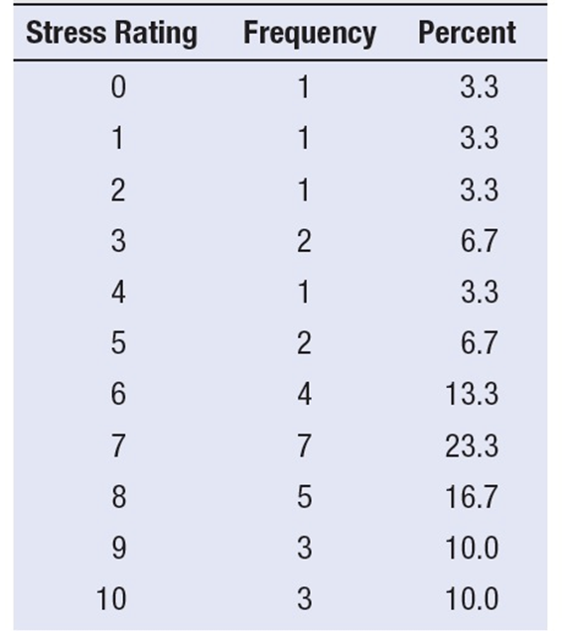
Analysing Data: Frequency Tables (2)
8,7,4,10,8,6,8,9,9,7,3,7,6,5,0,9,10,7,7,3,6,7,5,2,1,6,7,10,8,8
Notes:
Make a list down the page of each possible value, from lowest to highest
Go one by one through the scores, making a mark for each next to its value on the list
Make a table showing how many times each value on the list is used
Figure the percentage of scores for each value

Slide 28
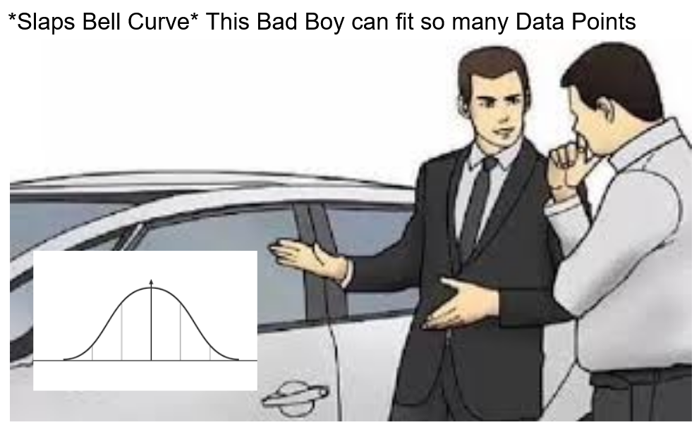
Analysing Data: Histograms
Frequency Distributions (aka Histograms)
  A graph plotting values of observations on the horizontal axis, with a bar showing how many times each value occurred in the data set.
The ‘Normal’ Distribution
  Bell shaped
  Symmetrical around the centre

Slide 29
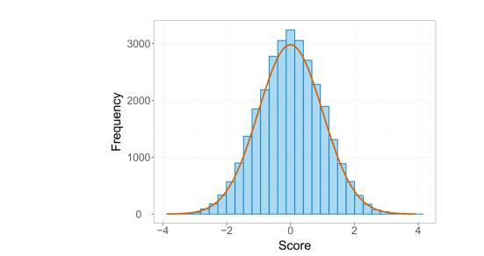
The Normal Distribution
Notes:
The normal distribution is a special type of histogram with a “bell” shaped curve

Slide 30
Properties of Frequency Distributions
Skew
  The symmetry of the distribution.
  Positive skew (scores bunched at low values with the tail pointing to high values).
  Negative skew (scores bunched at high values with the tail pointing to low values).
Kurtosis
  The ‘heaviness’ of the tails.
  Leptokurtic = heavy tails.
  Platykurtic = light tails.

Slide 31
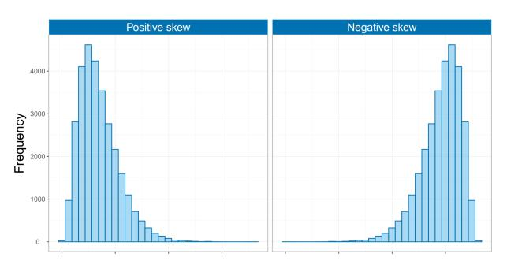
Skew

Slide 32
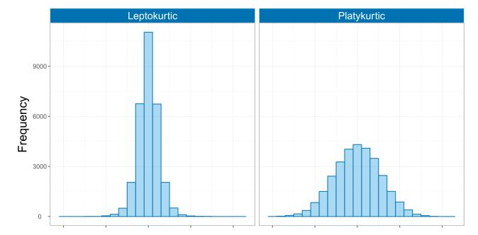
Kurtosis

Slide 33
Central Tendency: The Mode
Mode
  The most frequent score
Bimodal
  Having two modes
Multimodal
  Having several modes

Slide 34
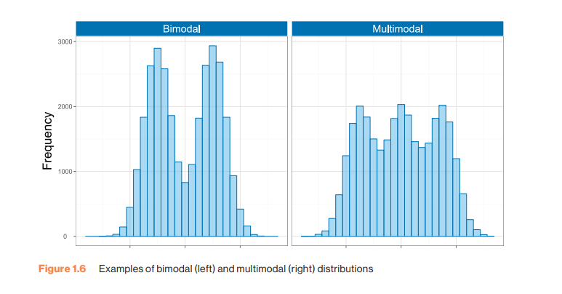
Bimodal and Multimodal Distributions

Slide 35
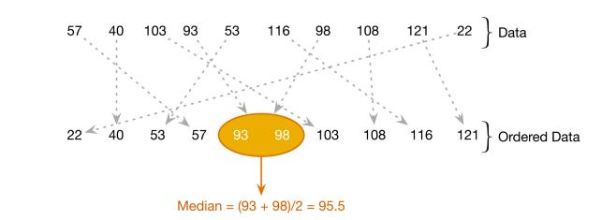
Central Tendency: The Median
Notes:
When the data contain an even number of scores, the median is the average of the middle two values

Slide 36
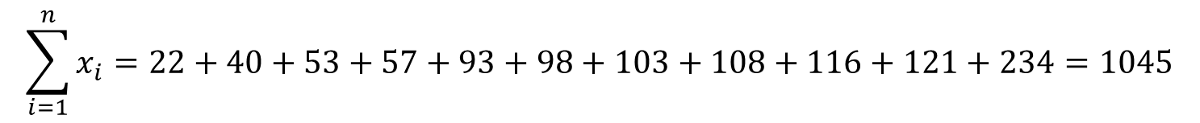
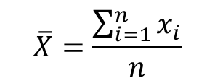
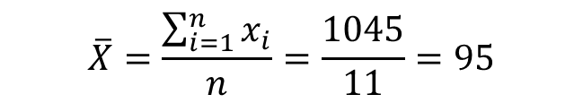
Central Tendency: The Mean
Mean
  The sum of scores divided by the number of scores.
  Number of friends of 11 Facebook users.
$$\overline{X}=\frac{\sum_{i=1}^{n}{x_{i}}}{n}$$
$$\sum_{i=1}^{n}{x_{i}}=\text{22}+\text{4}0+\text{53}+\text{57}+\text{93}+\text{98}+\text{1}0\text{3}+\text{1}0\text{8}+\text{116}+\text{121}+\text{234}=\text{1}0\text{45}$$
$$\overline{X}=\frac{\sum_{i=1}^{n}{x_{i}}}{n}=\frac{1045}{11}=95$$

Slide 37
The Dispersion: Range
The Range
  The smallest score subtracted from the largest
  For our Facebook friends data the highest score is 234 and the lowest is 22; therefore, the range is 234 − 22 = 212.

Slide 38
The Dispersion: The Interquartile Range (1 of 2)
Quartiles
  The three values that split the sorted data into four equal parts.
  Second quartile = median.
  Lower quartile = median of lower half of the data
  Upper quartile = median of upper half of the data

Slide 39
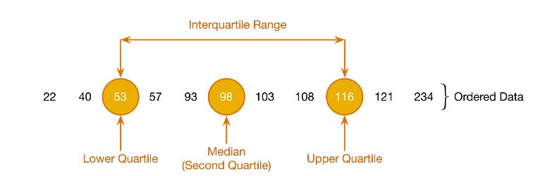
The Dispersion: The Interquartile Range (2 of 2)

Slide 40
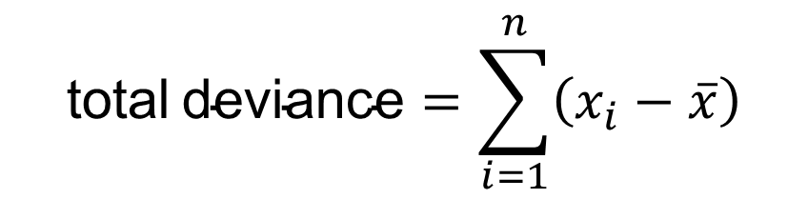

Deviance
We can calculate the spread of scores by looking at how different each score is from the center of a distribution e.g. the mean.
$$\text{deviance}\text{= }x_{i}−\overline{x}$$
$$\text{total} \text{deviance}=\sum_{i=1}^{n}{\left(x_{i}−\overline{x}\right)}$$

Slide 41
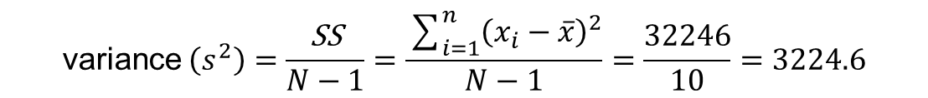
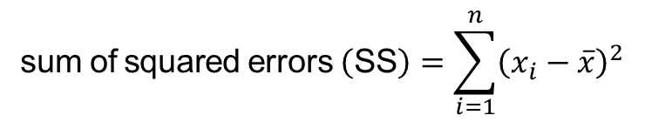
Sum of Squared Errors, SS
Indicates the total dispersion, or total deviance of scores from the mean:
It’s size is dependent on the number of scores in the data.
More useful to work with the average dispersion, known as the variance:
$$\text{sum} \text{of} \text{squared} \text{errors} \left(\text{SS}\right)=\sum_{i=1}^{n}{{\left(x_{i}−\overline{x}\right)}^{2}}$$
$$\text{variance} \left(s^{2}\right)=\frac{\text{SS}}{N−1}=\frac{\sum_{i=1}^{n}{{\left(x_{i}−\overline{x}\right)}^{2}}}{N−1}=\frac{32246}{10}=3224.6$$

Slide 42
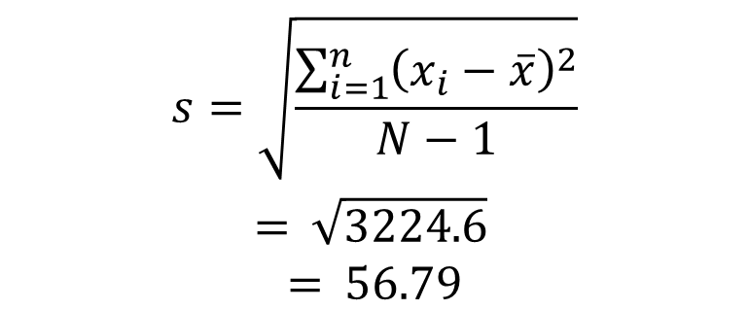
Standard Deviation
The variance gives us a measure in units squared.
  In our Facebook example we would have to say that the average error in our data was 3224.6 friends squared.
This problem is solved by taking the square root of the variance, which is known as the standard deviation:
$$\begin{matrix}s=\sqrt{\frac{\sum_{i=1}^{n}{{\left(x_{i}−\overline{x}\right)}^{2}}}{N−1}} \\ = \sqrt{3224.6} \\ = 56.79\end{matrix}$$

Slide 43
Step 1
Find the distance from the mean to each score (deviation score)
Step 2
Square each deviation score
Step 3
Sum up all squared deviations (Sum of Squares, SS)
Step 4
Divide the SS by the total number of observations (the variance)
Population Variance =
Step 5
Take the square root of the variance
Population Standard Deviation =
Notes:
There are five steps to calculating standard deviation

Slide 44
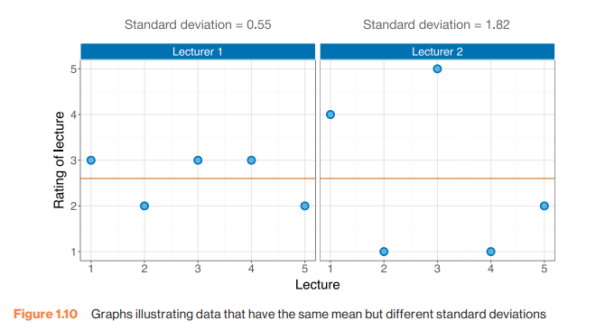
Same Mean, Different sd

Slide 45
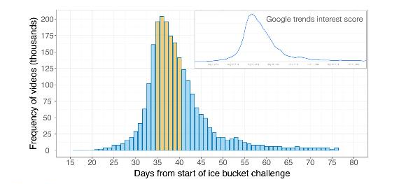
Using a Frequency Distribution to go Beyond the Data
Notes:
Figure 1.12 Frequency distribution showing the number of ice bucket challenge videos on YouTube by day since the first video (the inset shows the actual Google Trends data on which this example is based)

Slide 46
Important Things to Remember
The sum of squares, variance and standard deviation represent the same thing:
  The ‘Fit’ of the mean to the data
  The variability in the data
  How well the mean represents the observed data
  Error

Slide 47
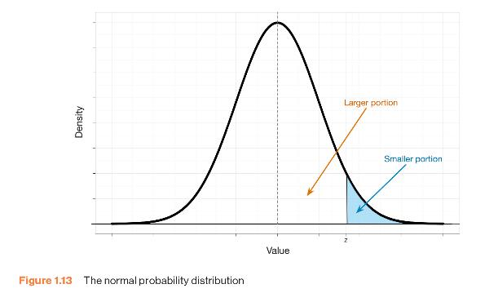
The Normal Probability Distribution

Slide 48
Going Beyond the Data: Z-scores
Z-scores
  Standardizing a score with respect to the other scores in the group.
  Expresses a score in terms of how many standard deviations it is away from the mean.
  The distribution of z-scores has a mean of 0 and SD = 1.

Slide 49

Z-Score Formula
$$z=\frac{X−\overline{X}}{s}$$

Slide 50
Properties of Z-scores
1.96 cuts off the top 2.5% of the distribution.
−1.96 cuts off the bottom 2.5% of the distribution.
95% of z-scores lie between −1.96 and 1.96.
99% of z-scores lie between −2.58 and 2.58.
99.9% of them lie between −3.29 and 3.29.

Slide 51
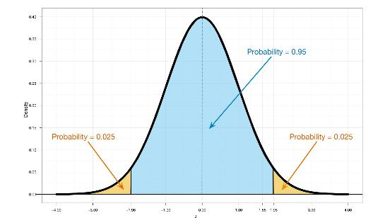
Probability Density Function of a Normal Distribution

Slide 52
Why use z-scores?
Can compare between individuals in different populations
Can compare between measures on different scales

Slide 53
Reporting Data (1)
Dissemination of Research
  Findings are presented at conferences and in articles published in scientific journals.

Slide 54
Reporting Data (2)
Knowing how to report data
  Chose a mode of presentation that optimizes the understanding of the data.
  If you present three or fewer numbers then try using a sentence.
  If you need to present between 4 and 20 numbers consider a table.
  If you need to present more than 20 numbers then a graph is often more useful than a table.

